Slide 1

COS 781 (Data Mining)
Theme 1
Introduction to Data Mining

Slide 2
Introduction to Data Mining
Further reading:
  Marcel Holsheimer and Arno PJM Siebes. Data Mining: The Search for Knowledge in Databases. Technical report CS-R9406, CWI (Centrum voor Wiskunde en Informatica), 1994.
  Jiawei Han, Data Mining: Concepts and Techniques, 3rd edition. Morgan Kaufmann Publishers, 2012.
  Ian H. Witten, Frank Eibe, Data Mining: Practical Machine Learning Tools and Techniques, 4th edition. Morgan Kaufmann, 2017.

Slide 3

What is Data Mining?
What is DATA?
What does MINING imply?

Slide 4
Data and Knowledge
Data:
  A representation of the state of an environment at any given time
Knowledge:
  Insight into an environment, as it is represented by a set of data, and which is not obvious from the data alone

Slide 5
Data and Knowledge
Knowledge
Data

Slide 6
Data
Data implies artefacts:
  Text
  Images
  Audio
  Video
  Combinations of these…

Slide 7
Data
Structured Data:
  Have a well-defined storage structure
  Uses a data model:
    Flat file (e.g. CSV file)
    Relational DBMS
    OODBMS
    Object-Relational Database

Slide 8
Data
Semi-Structured Data:
  Storage structure that varies from document to document
  e.g. Form archives, Q&A voice recordings
Unstructured Data:
  No storage structure at all
  e.g. Articles, novels, conversation recordings, news footage

Slide 9
Data
Application Areas:
  Transactional Databases
    Unique transaction identifier with a list of items making up the transaction
  Temporal Databases
    Include time-related attribute(s) to record time-based validity of facts in the database
  Time Series Databases
    Sequences of values that change over time

Slide 10
Data
Application Areas (continued):
  Spatial Databases
    e.g. geographic, chip design, medical, satellite
    Raster or vector format
  Multimedia databases
  The World Wide Web
    Highly unstructured…
    Mining path traversal patterns

Slide 11
Structured Data
Relational DBMS:
  Series of linked tables
  Usually one non-normalised table is assumed for data mining
  Use database queries (SQL) to access

Slide 12
Structured Data
Relation Name
Attributes
COMPANY | NAME | TURNOVER | AVG_REMUN | ISO9000 | SIZE | STATUS
 | Spark Motors | 50,000,000,000.00 | 5,400.00 | T | large | solvent
 | RDG | 23,000,000,000.00 | 8,150.00 | T | medium | insolvent
 | Red Starr | 20,000,000,000.00 | 4,200.00 | F | small | solvent
 | McDouglas Inc. | 25,000,000,000.00 | 4,120.00 | T | small | insolvent
Tuples

Slide 13
Structured Data
Data Warehouse:
  Repository of data from multiple sources:
    Stored using a unified schema
    Usually resides at a single site
    Data is automatically pre-processed
  Organisation:
    Grouped according to major subjects
    Data from a historical perspective
    Summarised values
  Often a data cube is used

Slide 14
Structured Data
Multi-dimensional data cube:
  Provides a multi-dimensional data view
  Facilitates fast data display
  On-Line Analytical Processing (OLAP)
    Supports analytical queries
    Access to summarised data
    Different granularity levels

Slide 15
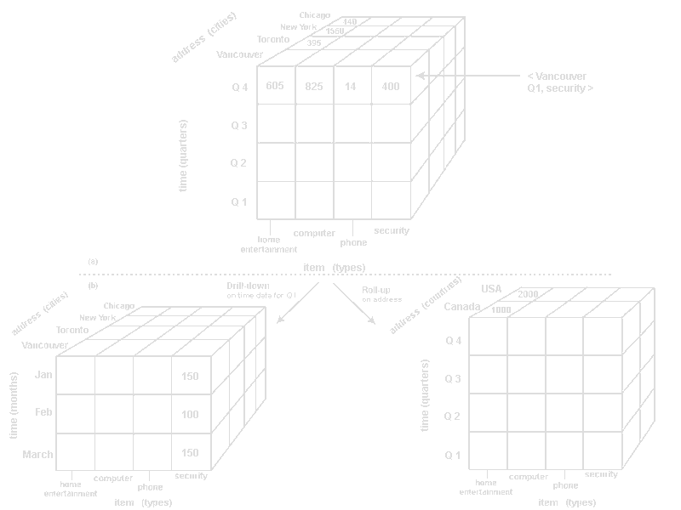
Structured Data

Slide 16
Structured Data
MapReduce
  A programming model
    Different implementations (e.g. Hadoop MapReduce)
    Processing big data sets in parallel over many nodes
  Composed of two procedures
    Map procedure
      Performs filtering and sorting
      Splits the task up into components
      Maps inputs into intermediate key-value pairs
    Reduce procedure
      Performs a summary operation
      Produces a result
      Combines intermediate key-value pairs into final results

Slide 17
Structured Data
MapReduce
  A simple example
    We have a set of documents
    We want to count the occurrences of each word
  Strategy
    The framework creates a series of mapper nodes
    Give documents (or parts of documents) to mapper nodes
    Each mapper node
      Processes through its document (or part of a document)
      Produces intermediate key-value pairs
      Key: A word occurring in the document
      Value: Count of the word (1, because the word occurs once)
      Intermediate results are stored locally on the node

Slide 18
Structured Data
Documents
Key-value pairs
Hello World Bye World
  Hello, 1
  World, 1
  Bye, 1
  World, 1
Mapper node 1
Hello Test Hello Bye
  Hello, 1
  Test, 1
  Hello, 1
  Bye, 1
Mapper node 2

Slide 19
Structured Data
MapReduce
  Strategy
  The framework creates a series of reducer nodes
    All key-value pairs with the same key are gathered together
    These key-value pairs are fed to the same reducer node
    This is referred to as shuffling
  If there are many instances of a key
    Multiple reducer nodes may handle the same key
    Reducers with the same key are grouped together
    This is referred to as sorting
  Finally, each reducer node processes its key-value pairs
    Totals the values for the key-value pairs
    Outputs the key with the total count as the final result
    This is referred to as reducing

Slide 20
Structured Data
Reducer
node 1
  Bye, 1
  Bye, 1
Bye, 2
Key-value pairs
  Hello, 1
  World, 1
  Bye, 1
  World, 1
  Hello, 1
  Hello, 1
  Hello, 1
Mapper
node 1
Reducer
node 2
Hello, 3
  Hello, 1
  Test, 1
  Hello, 1
  Bye, 1
Reducer
node 3
  Test, 1
Test, 1
Mapper
node 2
  World, 1
  World, 1
Reducer
node 4
Word, 2

Slide 21
Knowledge
Types of Knowledge:
  Logical consequences:
    Exploit deductions based on a data set
    May be derived from applied formal logic
  Generalisations:
    Exploit patterns (regularities) in data
    Expressed as a model
  What characteristics should useful knowledge have?

Slide 22
Patterns
Some requirements for patterns:
  Should add value
  Should be timely
  Should be generally applicable
  Should not be trivial
  Should be understandable
  Should be believable

Slide 23
Patterns
Requirements for DM tools & techniques
  Ability to mine a variety of pattern types
  Mining should be interactive
  Mine patterns at varying granularity levels
  Allow users to provide a priori knowledge “hints”
  Should associate quality measures with patterns
  Presentation and visualisation is very important
  Noisy and incomplete data must be handled

Slide 24
Patterns
Requirements for DM tools & techniques (continued)
  Performance:
    Efficiency
    Scalability
    Incremental mining
  Complexity:
    Variety of data formats
    Heterogeneous databases
    Distributed databases

Slide 25
Patterns
Types of Patterns:
  Class/Concept Descriptions
  Association Analysis
  Classification and Prediction
  Cluster Analysis
  Outlier Analysis
  Evolution Analysis

Slide 26
Class/Concept Descriptions
Data characterisation
  Builds a description of the characteristics of a target class of data patterns
  e.g. A general profile of customers who make high value purchases
Data Discrimination
  Builds a description of the characteristics of a target class compared to one or more contrasting classes
  e.g. A general profile of customers who maintain good credit versus those who do not

Slide 27
Association Analysis
Builds association rules that show attribute-value conditions that occur frequently within the data
e.g. Women who regularly use Dove soap also regularly use Organics shampoo
gender(X, "female")  soap(X, "Dove") ⇒
shampoo(X, "Organics")
[support = 5%, confidence = 70%]

Slide 28
Classification and Prediction
Determines a model (from training data) that predicts the classification of an object whose class label is unknown
May also predict an unknown data value
A set of production rules:
IF size = small AND ISO9000 = true THEN class = solvent
IF size = medium AND turnover >= 100000 THEN class = solvent
DEFAULT class = insolvent

Slide 29
Classification and Prediction
A decision tree:
SIZE
small
medium
large
ISO9000
solvent
TURNOVER
T
F
< 100000
>= 100000
solvent
insolvent
solvent
insolvent

Slide 30
Cluster Analysis
Groups “similar” data patterns together: Maximising intra-cluster similarity, minimising inter-cluster similarity
Class label not used (often unknown)
May be used to generate class labels
May be used to build taxonomies

Slide 31
Cluster Analysis

Slide 32
Outlier Analysis

Slide 33
Outlier Analysis
Data samples that do not comply with the general behaviour of the data set
May indicate patterns of interest
e.g. Analysis of characteristics for fraudulent transactions

Slide 34
Evolution Analysis
Models trends for time-variant data
May uncover historical patterns
May predict future movements

Slide 35
Learning
What, in general, do you understand under the term “learning”?

Slide 36
Learning
Definition:
  The process by which knowledge may be derived from a data source

Slide 37
Learning
Knowledge
Data
Learning

Slide 38
Learning
Categories:
  Deductive Learning
    Derives logical consequences
    e.g. SQL, DMQL, OLAP, formal logic
  Inductive Learning
    Derives generalisations

Slide 39
Learning
Machine Learning:
  Automatic, algorithmic approach to the inductive learning process
  Categories:
    Supervised
    Unsupervised
    Reinforcement learning

Slide 40
Knowledge Discovery Process
Knowledge Discovery in Databases (KDD)
  The entire process of knowledge extraction, from an unprocessed database to a useful presentation
  Data mining
    A possible component of this process
  Overall phases of KDD:
    Pre-processing
    Processing
    Post-processing

Slide 41
Knowledge Discovery Process
Why is a pre-processing phase required?
Why is a post-processing phase required?
Where could data mining fit in?

Slide 42
Knowledge Discovery Process
Expert System
Human Expert
Used by
Knowledge
Evaluation and
Presentation
Generalisations
And Patterns
Knowledge
Extraction
Selected Examples
Re-Integration
Selection and
Transformation
Data Warehouse
Cleaning and
Integration
Unprocessed
Data Sources

Slide 43
Knowledge Extraction
In our context, knowledge extraction
  Involves some form of machine learning
In what ways could a machine learning component be incorporated as a component in the KDD process?
  Is it independent, in and of itself?
  Is it a part of a larger process?

Slide 44
Knowledge Extraction
Selected Data
Patterns
DM Tool
Generalisations
and Patterns

Slide 45
Knowledge Extraction
Human
Expert
Interaction
Selected Data
Patterns
EDA Tool
Data
Visualisations
Generalisations
and Patterns

